Slide 1
Architecture of sequencer v4_01

Slide 2
Instruction memory
mem[0]
mem[1]
:
mem[510]
mem[511]
Overall design of the sequencer
Computer
load_prog( )
Sequencer
manual_mode( )
auto_mode( )
Computer
16-bits
Output port
Port[0]
Port[1]
Port[2]
Port[3]
read_prog( )
16-bits
Auto
Manual
PC (program counter)
16-bits
16-bits
48-bits
Counter input MUX
Register
reg[0]
reg[1]
:
:
reg[30]
reg[31]
Data memory
mem[0]
mem[1]
mem[2]
:
:
mem[1022]
mem[1023]
external_output
connected to ja_3, ja_7, jb_1, jb_3, jb_5, jb_7, ja_0, ja_1, ja_4, ja_5, ja_6
jb_0
16-bit counter
16-bits
0
1
:
12
13
14
15
16-bits
jb_2
16-bit counter
jb_4
16-bit counter
16-bits
jb_6
16-bit counter
:
15: to jb_0_counter_enable
14: to jb_2_counter_enable
13: to jb_4_counter_enable
12: to jb_6_counter_enable
:
16-bit stopwatch
16-bit stopwatch
16-bit stopwatch
16-bit stopwatch
ja_2
16-bit stopwatch
16-bits
from jb_0_stopwatch_stopped : 15
from jb_2_stopwatch_stopped : 14
from jb_4_stopwatch_stopped : 13
from jb_6_stopwatch_stopped : 12
from ja_2_stopwatch_stopped : 10
: 09
: 08
: 07
: 06
: 05
: 04
: 03
: 02
: 01
: 00
15: to jb_0_counter_reset
14: to jb_2_counter_reset
13: to jb_4_counter_reset
12: to jb_6_counter_reset
11: to jb_0_stopwatch_start
10: to jb_2_stopwatch_start
09: to jb_4_stopwatch_start
08: to jb_6_stopwatch_start
07: to ja_2_stopwatch_start
06: to jb_0_stopwatch_reset
05: to jb_2_stopwatch_reset
04: to jb_4_stopwatch_reset
03: to jb_6_stopwatch_reset
02: to ja_2_stopwatch_reset
01:
00:
16-bits
16-bits
16-bits
Trigger level in
64-bits
Trigger out
Output FIFO
Output at T
Output at T-1
Output at T-2
Output at T-3
:
:
Depth: 1024
fifo_data_length( )
read_fifo_data( )
Any new changes compared to v4_00 are colored in red
Computer

Slide 3
Any new changes compared to v4_00 are colored in red
External input pins
Counter input MUX
Auto/manual mode
jb_0
16-bit counter
16-bits
0
1
2
3
4
5
6
7
8
9
10
11
12
13
14
15
Computer
External output pins
jb_2
16-bits
update_bit_pattern( )
read_bit_pattern( )
manual_mode( )
auto_mode( )
16-bit counter
jb_4
16-bits
15: to ja_3 pin
14: to ja_7 pin
13: to jb_1 pin
12: to jb_3 pin
11: to jb_5 pin
10: to jb_7 pin
9: to ja_0 pin
8: to ja_1 pin
7: to ja_4 pin
6: to ja_5 pin
5: to ja_6 pin
:
16-bit counter
15
14
:
1
0
jb_6
16-bit counter
16-bits
Output port
Port[0]
16-bits
Auto
Manual
16-bits
Patterns[17:32]
17
18
:
31
32
16-bits
16-bit stopwatch
16-bits
16-bits
external_output[15:0]
16-bit stopwatch
16-bit stopwatch
16-bits
monitoring_32bits[1:32]
16-bit stopwatch
16-bits
ja_2
16-bit stopwatch
16-bits
Copy of external_output[15:0]
manual_control_on
stopped
00000
Copy of PC (program counter)
update_bit_pattern( )
read_bit_pattern( )
Computer
Patterns[1:16]
16-bits
1 | 2 | … | 15 | 16 | 17 | 18 | 19 | … | 23 | 24 | 25 | … | 31 | 32
Copy of trigger_level_in
16-bits
escape_read( )
Remaining clock counts when wait instruction was interrupted by the specified trigger_level_in
16-bits
Computer

Slide 4
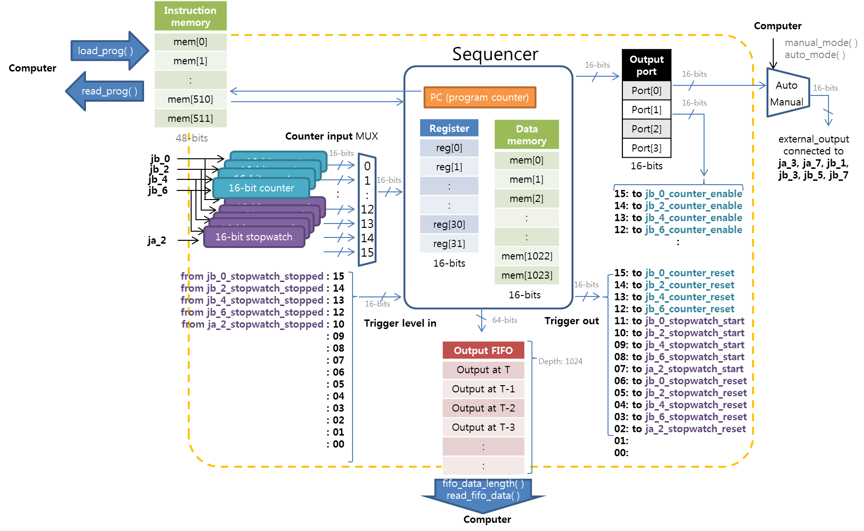
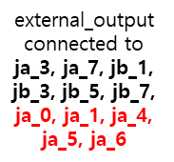
Instructions and flow of information
jump
branch_lt
branch_eq
add
sub
loadi
set
read
load_word
trigger_out
store_word
write
wait

Slide 5
I/O details of counters and stopwatches
16-bit counter
Counter will accumulate the number of clocks while clock_enable is high.
The counts in the counter won’t be reset until the explicit reset will be given.
clock
16-bits
counter_output
reset
clock_enable
Coming from jb_x input pins
To counter_input ports
From output_port[1] pins
From trigger_out pins
Stopwatch will accumulate the number of 800MHz clocks between start and stop rising edge.
Until explicit reset is given, stopwatch won’t start again.
Stopwatch_output value is not reliable until stopwatch_stopped signal goes high.
Stopwatch_stopped signal is generally connected through trigger_level_in pins, and trigger_level_in can be also read through port[14] of counter_input.
stop
16-bit stopwatch
16-bits
stopwatch_output
start
stopwatch_stopped
reset
To trigger_level_in pins
From trigger_out pins

Slide 6
Block diagram of the sequencer

Slide 7
Any new change compared to v3_04 should be colored in red
- No change yet as of 2/5/2018
Counter[14]
Start
Trigger_level_in [15:0]
CLK
……
run_jump_wait
remaining_counts
Connected to counter[15]
PC_clk_enable
write_source
reset_PC
mem_write
Opcode
pulse_enable
instr[63:56]
Controller
imm3
47:32
update_masked_pattern
Outputs from (16) 16-bit counters
imm1
31:16
fifo_we
imm2
15:0
rdA_eq_rdB
CLK
rdA_lt_rdB
reg_write
ALU_src
……
CLK
ALU_control
01
PC’
PC
instr
WE3
RD1
rd1
00
A
RD
r1
A1
ALU
ALU_out
10
Instruction Memory
instr[55:48]
RD2
rd2
r2
A2
00
CLK
instr[47:40]
RD3
01
PC_wait
r3
rd3
10
counter_MUX_output
instr[39:32]
A3
Register File
WE
Imm1[3:0]=counter_select
WD3
+
imm1
instr[31:16]
Output FIFO
00
1
imm3
01
Result_MUX_output
PC_run
instr[47:32]
10
PC_jump
imm2
instr[15:0]
11
ADDR
WE
CLK
D_IN
D_OUT
WE
Data memory
bits
ADDR
:
bits
:
Output ports[1:0]
pulse_en
CLK
masks
Trigger out [15:0]
Output Pattern
16-bits
Trigger

Slide 8
opcode | internal_run_jump_wait (RJW) | reg_write | ALU_control | ALU_src | write_source | fifo_we | update_masked_pattern | mem_write | pulse_enable
NOP(00) | 00 (run) | 0 | X | X | XX | 0 | 0 | 0 | 0
Add (02) | 00 (run) | 1 | 0 (add) | 00 (rd2) | 01 (ALU_out) | 0 | 0 | 0 | 0
Addi (03) | 00 (run) | 1 | 0 (add) | 01 (imm1) | 01 (ALU_out) | 0 | 0 | 0 | 0
Sub (04) | 00 (run) | 1 | 1 (subtract) | 00 (rd2) | 01 (ALU_out) | 0 | 0 | 0 | 0
Subi (05) | 00 (run) | 1 | 1 (subtract) | 01 (imm1) | 01 (ALU_out) | 0 | 0 | 0 | 0
Loadi(06) | 00 (run) | 1 | X | X | 10 (imm1) | 0 | 0 | 0 | 0
read(07) | 00 (run) | 1 | X | X | 00 (counter[imm1]) | 0 | 0 | 0 | 0
Set(08) | 00 (run) | 0 | X | X | XX | 0 | 1 | 0 | 0
write(09) | 00 (run) | 0 | X | X | XX | 1 | 0 | 0 | 0
Blt (0A) | If rdA_lt_rdB == 1, 01(jump) else 00(run) | 0 | X | 00 (rd2) | XX | 0 | 0 | 0 | 0
Blti (0B) | If rdA_lt_rdB == 1, 01(jump) else 00(run) | 0 | X | 10 (imm3) | XX | 0 | 0 | 0 | 0
Beq (0C) | If rdA_eq_rdB == 1, 01(jump) else 00(run) | 0 | X | 00 (rd2) | XX | 0 | 0 | 0 | 0
Beqi (0D) | If rdA_eq_rdB == 1, 01(jump) else 00(run) | 0 | X | 10 (imm3) | XX | 0 | 0 | 0 | 0
Jump(0E) | 01(jump) | 0 | X | X | XX | 0 | 0 | 0 | 0
Stop(0F) | 10(wait) | 0 | X | X | XX | 0 | 0 | 0 | 0
load_word(11) | 00 (run) | 1 | X | X | 11 | 0 | 0 | 0 | 0
store_word(12) | 00 (run) | 0 | X | X | XX | 0 | 0 | 1 | 0
Trigger_out (13) | 00 (run) | 0 | X | X | XX | 0 | 0 | 0 | 1
wait (14) | 10(wait) | 0 | X | X | XX | 0 | 0 | 0 | 0
waiti (15) | 10 (wait) | 0 | X | X | XX | 0 | 0 | 0 | 0

Slide 9
Trigger_level_in [15:0]
start
stopped
To counter[14]
…
clk
Opcode
instr[63:56]
Controller
imm3
47:32
imm1
31:16
fifo_we
imm2
15:0
Remaining_counts
reg_write
ALU_control
update_masked_pattern
PC_clk_enable
ALU_src
reset_PC
rdA_lt_rdB
Connected to counter[15]
write_source[1:0]
rdA_eq_rdB
mem_write
run_jump_wait[1:0]
pulse_enable
PC
A
RD
instr
clk
Instruction Memory
Outputs from (14) 16-bit counters
:
CLK
rd1
WE
Datapath
rd2
rd3
Output FIFO
16-bits
imm1
Output ports [1:0]
:
…
sequencer
Trigger out [15:0]

Slide 10
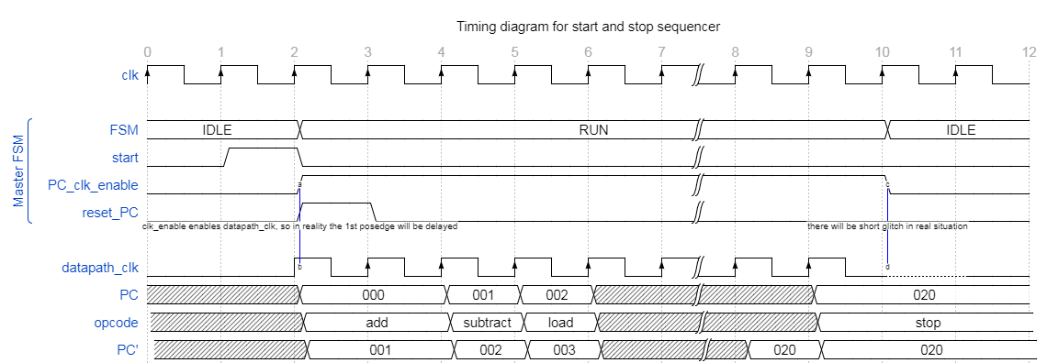
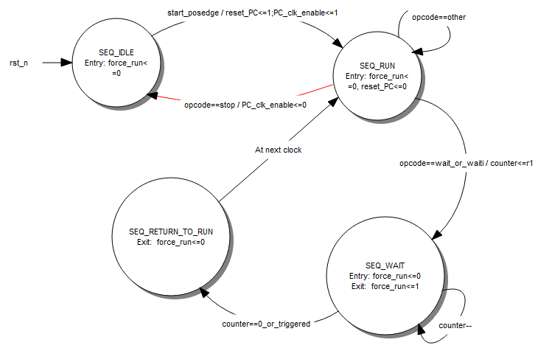
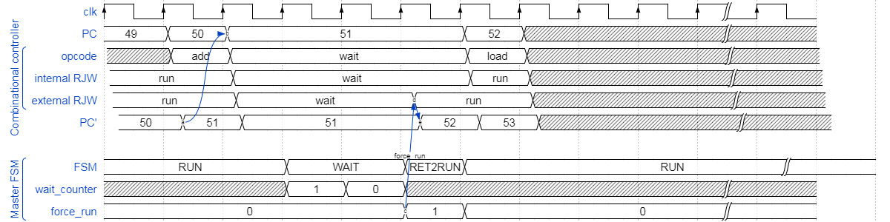
Special logic to handle WAIT
- WAIT command requires minimum 3 clocks rather than 1 clock

Slide 11
To-do list
The port_number parameter of set_output_port instruction is immediate value, but it is stored as if it is the index of reg3 in the instruction code. In the future, it should be stored as imm3.

Slide 12
PC
sequencer
manual_mode( )
auto_mode( )
External inputs
output_port[0]
External outputs
Auto
Manual
16-bits
Instruction memory
mem[0]
mem[1]
:
mem[510]
mem[511]
64-bits
counter_input port[13]
stopped
Output FIFO
Output at T
Output at T-1
Output at T-2
Output at T-3
:
:
“START SEQUENCER”
Depth: 1024
1 | 2 | … | 15 | 16 | 17 | 18 | … | 31 | 32
“LOAD_PROG”
patterns
READ_PROG”
FSM
“UPDATE BITS”
“READ BITS”
“DATA LENGTH”
“READ DATA”
CMD-type data
data_fifo_dout
data_receiver
CMD data
BTF data
BTF-type data
TX_buffer1
CMD_Buffer
“#<num_dgt><byte_cnt><raw_data>\r\n”
send_command( )
“!<byte_cnt><ASCII_string>\r\n”
“!<byte_cnt><ASCII_string>\r\n”
BTF_Buffer
TX_buffer2
PC
send_mod_BTF_string( )
“#<num_dgt><byte_cnt><raw_data>\r\n”
“#<num_dgt><byte_cnt><raw_data>\r\n”
PC
“\x10C”, “\x10R”, “\x10T”,
“\x10A”, “\x10W”
esc_char
esc_char
bits_to_send
“#<num_dgt><byte_cnt><raw_data>\r\n”
Monitoring_32bits | 1 | … | 16 | 17 | … | 23 | 24 | … | 32
data_sender

